Slide 1
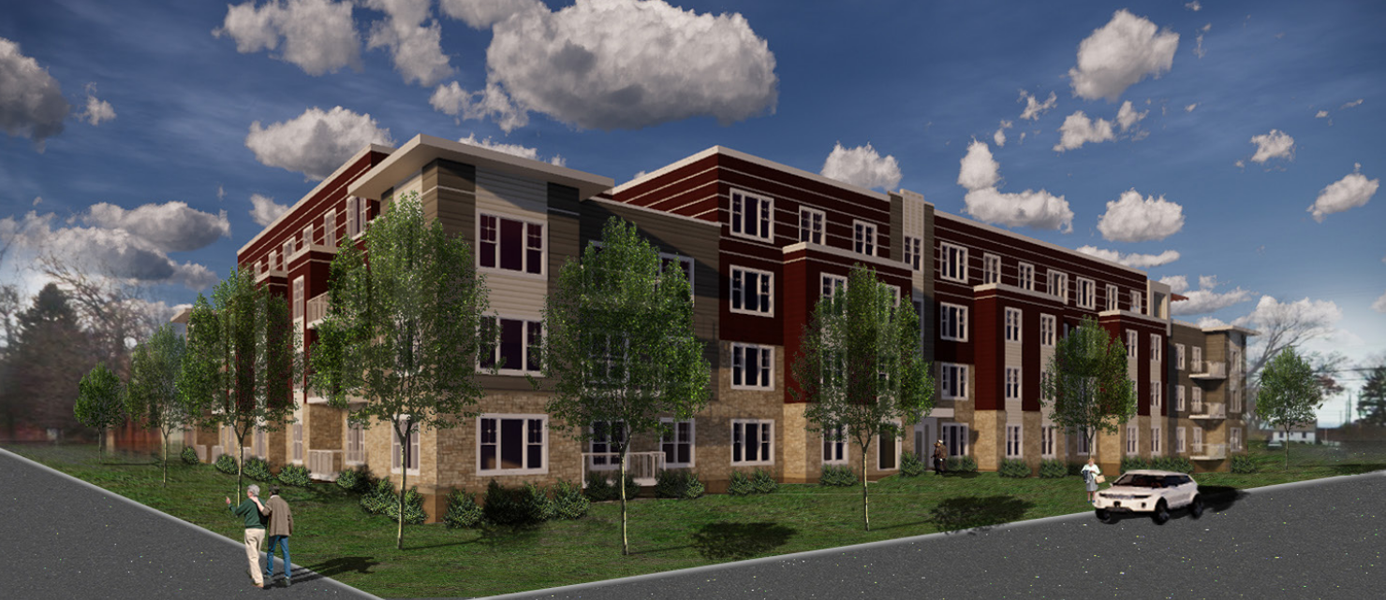
An Important Housing Resource for the City of Lauderdale
Notes:
Need to change logo on bottom to make them each pretty neutral.

Slide 2
Real Estate Equities
Experienced and Committed Owners since 1972
Real Estate Equities is a residential property management and ownership company based in St. Paul currently operating mainly in Minnesota, Indiana, and Wisconsin.
Real Estate Equities is a premier property management company that believes in providing housing that builds communities and enhances the lives of others all while instilling our values of Ownership, the Right Attitude, Knowledge, and Integrity.
Real Estate Equities has developed and managed more than 70 projects in excess of 11,000 housing units with projects spanning from Minnesota, Wisconsin, Ohio, Missouri, South Dakota as well as Indiana.
1,200 units currently under development today
Real Estate Equities will develop and operate all aspects of the property and will remain as owners for 20+ years.
Notes:
Ask Alex about 600 unit mark
Core values….

Slide 3
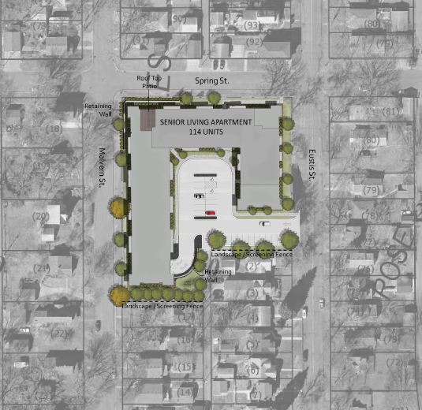
114 Affordable Senior Apartments
New Landscaping and connections to surrounding community.
Unit Mix:
One-bed/One Bath = 89
Two-bed/Two Bath = 25
Parking – Auto (1.07 ratio)
122 Total Stalls
(98 u/g & 24 surface)

Slide 4
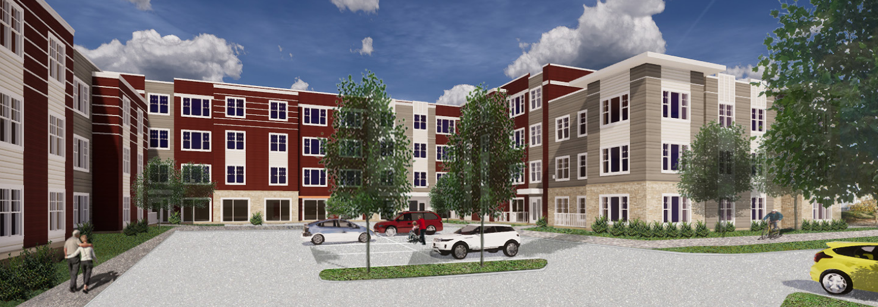
Perspective: Parking Lot

Slide 5
Projected Rents
The Proposed Project will be affordable at persons at or below 60% of the area median Income (AMI)
Through Income Averaging (i.e. some affordable at 50% of AMI and below, majority at 60% of AMI and below and some at 70% of AMI and below).
In addition, the rent that can be charged for the units is restricted as well. Below are the 2018 income and rent limits.
Income Limit By Household Size
Rent Limit by Unit Size
Income/Rent Limit
1 Person
2 Person
Rent Studio
Rent 1BR
Rent 2BR
50% AMI
$35,000
$40,000
$806
$837
$1,030
60% AMI
$42,000
$48,000
$981
$1,047
$1,255
70% AMI
$49,000
$56,000
$1,1565
$1,234
$1,480

Slide 6
PERspective: Spring Street & Eustis Street
Notes:
Need to change logo on bottom to make them each pretty neutral.

Slide 7
Sustainable Project Elements
Minnesota Green Community Standards
Low Flow Water Fixtures
Energy Star Appliances
High Efficency HVAC

Slide 8
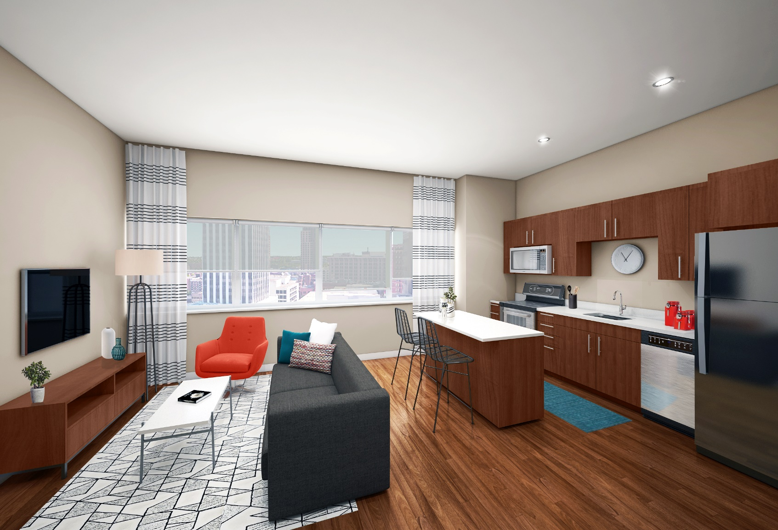
Resident Unit Amenities
Unit Amenities:
In-Unit washer & dryer
Solid Surface Countertops
9 Foot Ceiling Height
Full Stainless Steel Appliance Package
Low Flow Fixtures, LED Lighting, High Efficiency HVAC
Facility Usage:
2 Elevators
Dedicated Move-In Areas
Secure Entries

Slide 9
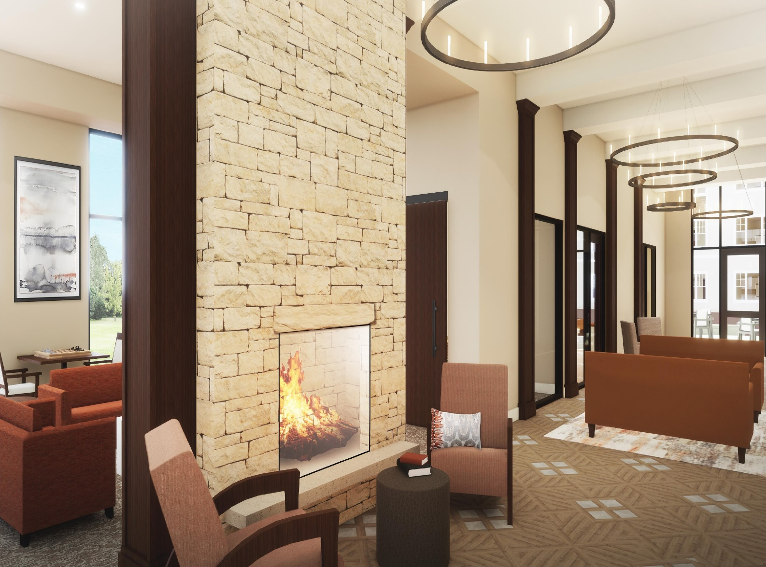
Resident Community Amenities
Four Person Onsite Management team
Secure resident entrance lobby with dedicated package storage
Community Room with Rooftop patio and fire pit
^{Fitness Center}
^{Dedicated underground Parking}
Notes:
Ask Alex about picture

Slide 10
Questions?

