Slide 1
2022 St. Anthony Police Department Annual Lauderdale Report
Jon Mangseth Police Chief
____________
Notes:
Abbreviating reading that emphasizes service mindset.

Slide 2
Department Summary
Department Strength
Department Fleet
20 - Full Time Police Officers (4 contract)
4 - Volunteer Reserve Officers (Authorized for 14)
1 - Full Time Community Service Officer
2 - Full Time Civilian Support Staff
6 - Marked Squads
1 - Marked Reserve Unit
1 - Marked CSO Unit
5 – Passenger vehicles assigned to Chief, Captain, Detective & Special Detail

Slide 3
Lauderdale Part I Crimes
Crime Statistics
Notes:
Since 1930 the FBI has administered the Uniform Crime Reporting System (UCR).
It is a system that compiles statistics on Part 1 and Part 2 crimes. All law enforcement agencies across the nation collect and report this data to the FBI.
Part 1 crimes are the most serious offenses and are reflected in this slide.
Meant as a brief overview only.
Lauderdale experienced a 0.5384615 (53.84%) decrease in Burglary, a 0.5789473 (57.89%) increase in theft (increases associated with catalytic converter thefts 2020 (9) 2021 (12) 2022 (16)), and a 0.83333 (83%) increase in M/V Theft.
St. Anthony has experienced a 94 % increase in Burglary, a 26.5% increase in Theft and 160% increase in MV Thefts.
Much like other areas, St. Anthony has experienced a 94 % increase in Burglary, a 26.5% increase in Theft and 160% increase in MV Thefts.
Burglaries of underground garages with multiple victims. Thefts associated with retail locations and increases associated with catalytic converter thefts. 2020 (23) 2021 (38) 2022 (47).

Slide 4
Lauderdale Part II Crimes
Crime Statistics
Notes:
Part 2 crimes are less serious and include those in this slide.
Influenced more by officer initiated activity including:
Alcohol violations such as DWI, Open Bottle, Minor Possession and Minor Consumption.
False Information to Police Officers.
Drug and Tobacco Offenses.
No significant changes from the preceding two years.
Forgery – occur through banking institutions/transactions.

Slide 5
Part I and II Crimes by Year
Notes:
This is an illustration of where Part 1 and Part 2 crimes have been trending since 2018.
The Minnesota Crime Data Explorer (www.cde.state.mn.us) contains data submitted by all Minnesota Law Enforcement agencies. The Crime Data Explorer began use of force data in 2020 and additional data begins 2021 and forward.

Slide 6
Investigation Review
Total Criminal Cases 144
Total Cases Cleared 48
Total Cases Cleared by Arrest 36
Total Cases Cleared by Other 12
Notes:
These crimes are typically more complex in terms of patrol officer response and investigative resources. 0.33333 or 33% clearance rate.
Captain Jeff Spiess – in charge of operations to include Investigations and Patrol – 25 years.
Det. Kiel Rushton and Det. Jonathan Schlingman. At the end of 2022, we bolstered the depth of the team by transitioning the “rotating investigator” position into one that is longer in tenure (3 years). Our detectives investigate every crime that occurs in the City, ranging from minor misdemeanors all the way up to violent felonies.

Slide 7
Calls for Service
Notes:
Calls for service have experienced a decrease since 2019, but I highlight that the complexity of the calls and time spent on these calls have not.
For example, calls that involve a mental health incident have increased:
LDL = 2019 (30), 2020 (10), 2021 (10), 2022 (51).
SA = 2019 (116), 2020(80); 2021 (140), 2022 (119).
LMC - Around 7 to 10% of police contacts involve people with mental illness, and
Over 90% of officers on patrol are estimated to have at least a handful of encounters with people in crisis each month.
TZD Events, Parking – snow events.

Slide 8
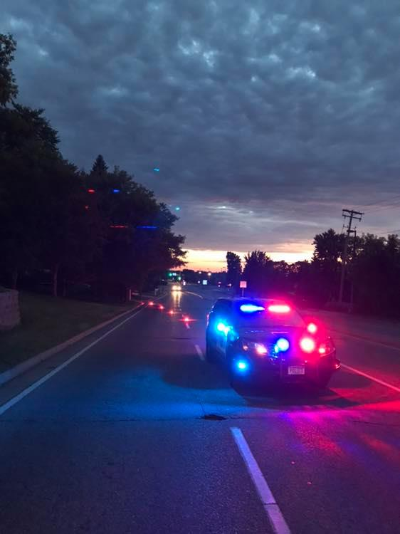
Patrol Review
16 personnel assigned to Patrol
Four Shifts; 1 supervisor and 3 officers
Responds to 911 calls
Proactive Patrol
Community Building
Crime Detection and Deterrence
Traffic Safety Initiative
Notes:
The patrol division continued with their commitment to community by “patrolling with a purpose.” St. Anthony patrol officers pride themselves with a patrol strategy based on data driven facts, recent crime trends, and citizen complaints. This strategy keeps us aligned with our department’s overall strategic plan, while adhering to our mission and vision statement.
In addition to their primary role of patrol, nearly all officers have additional responsibilities such as bike patrol, DARE, property & evidence technician, community engagement/social media & SWAT to name a few.
One of the most frequent citizen complaints the patrol division receives are reports of aggressive driving. This year, many communities throughout the Minneapolis/St. Paul metropolitan area reported a large increase in street racing and dangerous driving behavior. St. Anthony patrol officers worked vigorously to preserve motorist and pedestrian safety by conducting directed patrols that focused on deterring these aggressive drivers. Patrol officers also participated in several weekend collaborative patrols with neighboring agencies that focused on street racing in and around St. Anthony / Lauderdale.

Slide 9
Patrol Review Reason for the Stop Data
Notes:
In line with our traffic safety initiative focusing on driving conduct that has the highest potential for causing crashes, injuries and deaths on our roadways, the vast majority of traffic stops were for the reasons depicted on this slide. The largest category being moving which focuses on driving conduct with a traffic safety focus.
2021 Vehicle 10%, Inv. 5%, 911 Call 2%, Moving 83%.
Make comparison between past years. Mention traffic report upcoming.
Part of department’s strategic plan has been traffic safety. What causes injuries and deaths: aggressive driving. Also what our community cares about.
Traffic Data report available May 2023.
Use of Force Data Report May 2023.

Slide 10
Education Summary
Training Objective
Provide continued professional development, enhance safety of officers and community & foster unity of purpose and cooperation with the community.
______________________________________________
All training reviewed for content by the MN P.O.S.T. Board and/or St. Anthony PD Command to ensure adherence with Strategic Plan
Utilize both virtual and in-person platforms
Total training hours =1615
Notes:
Officers continue to meet and exceed licensing requirements for training in impartial/bias policing, crisis intervention.
The objectives of the training program are to:
- Provide for continued professional development of department personnel.
- Enhance the safety of officers and the community.
- Foster unity of purpose and cooperation with the community that they serve and to enhance the image of the department.
-All training has been reviewed for content by the MN P.O.S.T. Board and/or the St. Anthony P.D. command staff to ensure our police officers are receiving training that clearly falls in line with the learning objectives set forth by the department mission.
-We continue to recognize the need to assist officers with alternative response options and training when confronted with those experiencing a mental health or crisis situation. All sworn officers continue received Crises Intervention Team training (CIT). The training provided verbal techniques in a safe and compassionate alternative way of dealing with individuals in need of mental health or crisis assistance.
2021 Total training hours =2062

Slide 11
Education Summary
Notes:
Annual Post License Mandated Training includes Employee Wellness, Suicide Prevention, Implicit Bias, Autism, De-Escalation, Mental Health and 72-Hour Crisis Holds, Firearms, Emergency Vehicle Operations and U of Force.
Department Policy: Daily Training Bulletins via Lexipol.
Elected: Officers elect training that supports department’s strategic plan and Officer individual skill sets.

Slide 12
Police Reserves
Trained volunteers who logged 308 hours of service in 2022
Duties include:
Park Patrol
Animal Control
Transports
Vehicle Impounds
Vacation Home Checks
Community Events
Notes:
Of note:
-Currently have three Reserve Officers (14 authorized)
-Looking for more.

Slide 13
Social Media
Social Media Team:
Officers use social media as a method of effectively informing the public about department services, issues, investigations and other relevant events.
5400 Followers
5843 Followers
2085 Followers
Notes:
Team of four officers who post: Sgt. Huddle, Det. Rushton, Sergeant South, and Det. Schlingman. This is intentional, so we can be more timely in delivery of information impacting the community. Post about very serious things…and sometimes not so serious. Review in Two. Videos produced traffic stops and recruitment.
Facebook, Instagram, Twitter.

Slide 14
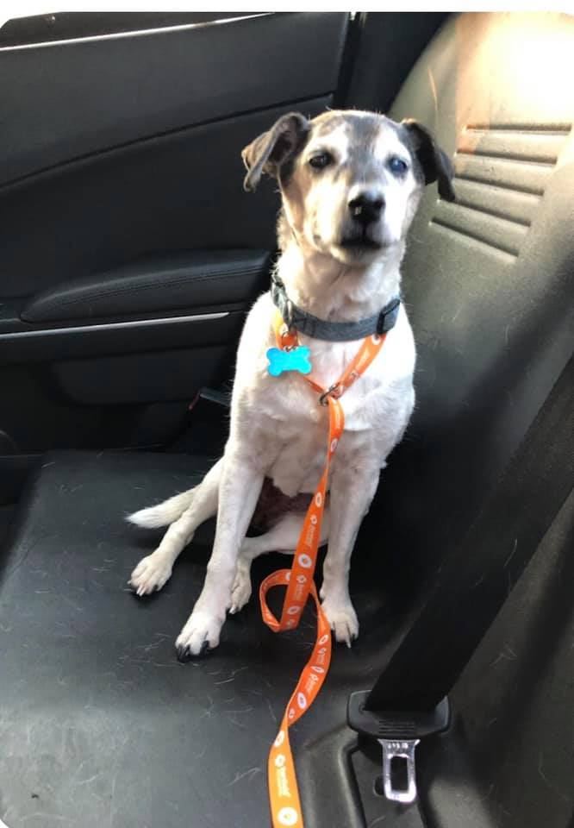
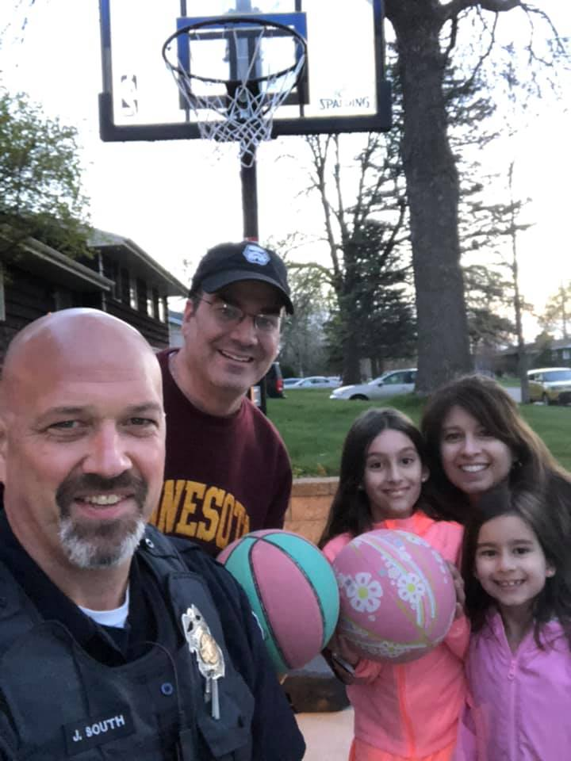
Social Media

Slide 15
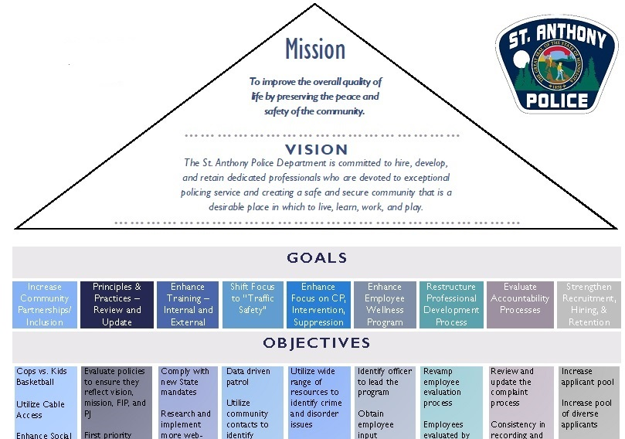
Community Engagement
Notes:
Community Engagement is a high priority and always will be. In 1829, Sir Robert Peel established the London Metropolitan Police Force and he became known as the “Father of Modern Policing.” His commissioners established a list of 9 policing principles that remain just as crucial today as they were then. Most of these principles specifically mention the necessary and unbreakable link between the public and the police. I think Principle 7 really captures well our focus as we seek to strengthen our relationship with the community: “To maintain at all times a relationship with the public that gives reality to the historic tradition that the police are the public and that the public are the police, the police being only members of the public who are paid to give full-time attention to duties which are incumbent on every citizen in the interests of community welfare and existence.”

Slide 16
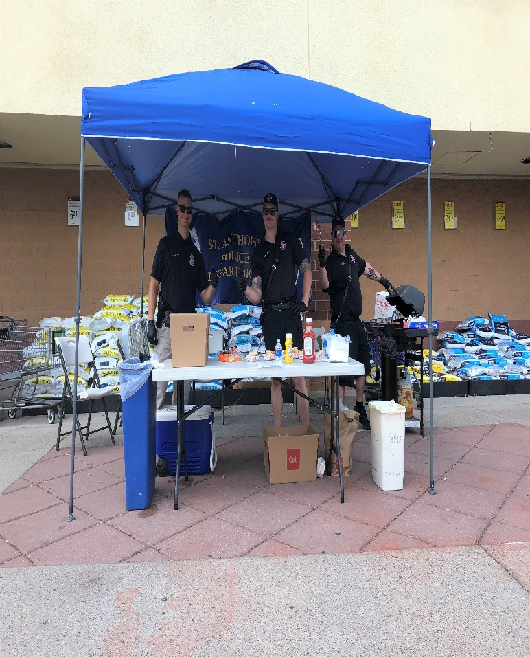
Community Engagement
Our Team
Every officer is a community engagement officer and every encounter is engagement
Team of four
Operates social media
Meets quarterly to plan
Organizes community events and presents to the public
Develops youth and other programs as a form of engagement and education
Notes:
The commitment to partner with, educate and learn from the communities we serve is a primary goal of our agency. In fact, it exists as the first listed goal in our department’s Strategic Plan. Though our department was challenged with staffing shortages through 2022, our priorities in working to accomplish our goal remained in place. While every officer in our department is expected to support this goal and seek opportunities to enhance it, we also have specific officers assigned to a Community Engagement Team. Sgt. Huddle, Sgt. Jim South, Det. Jon Schlingman, Det. K. Rushton.
These officers develop and coordinate community oriented programs aimed at making our community safer and more inclusive.
Some of our youth programs include:
Hosting an annual Summer Survival/Safety School
Kids’ bike safety course (Supported by BikeMN)
Regularly speaking at Home Alone classes through Community Services
Participating in the local Boy Scout Open House and Pinewood Derby races
Organizing and hosting Cops Vs. Kids Basketball game events
The department also offers the following opportunities for anyone.
SAPD Community Academy
Patrol Ride-Along
Scam Prevention Seminars
Presentations to Community Groups Upon Request
MN Night to Unite

Slide 17
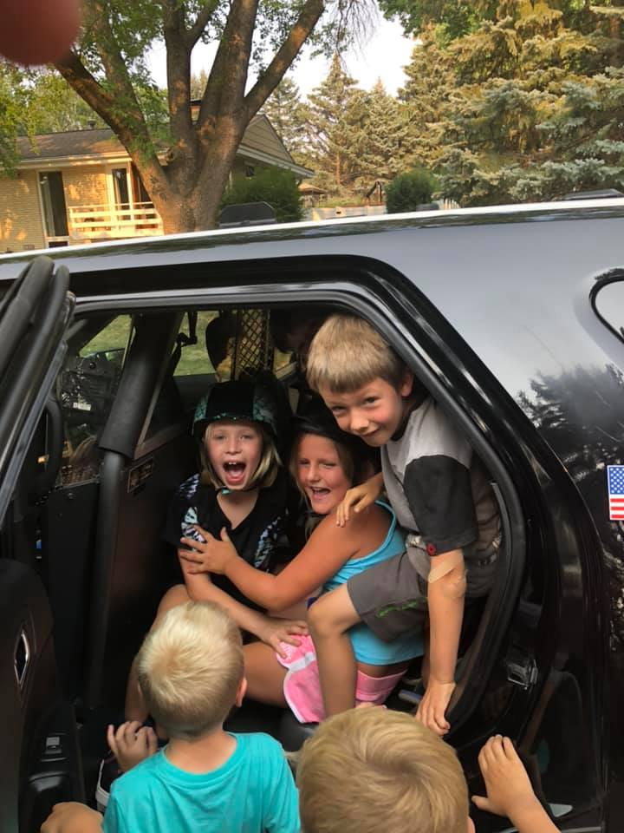
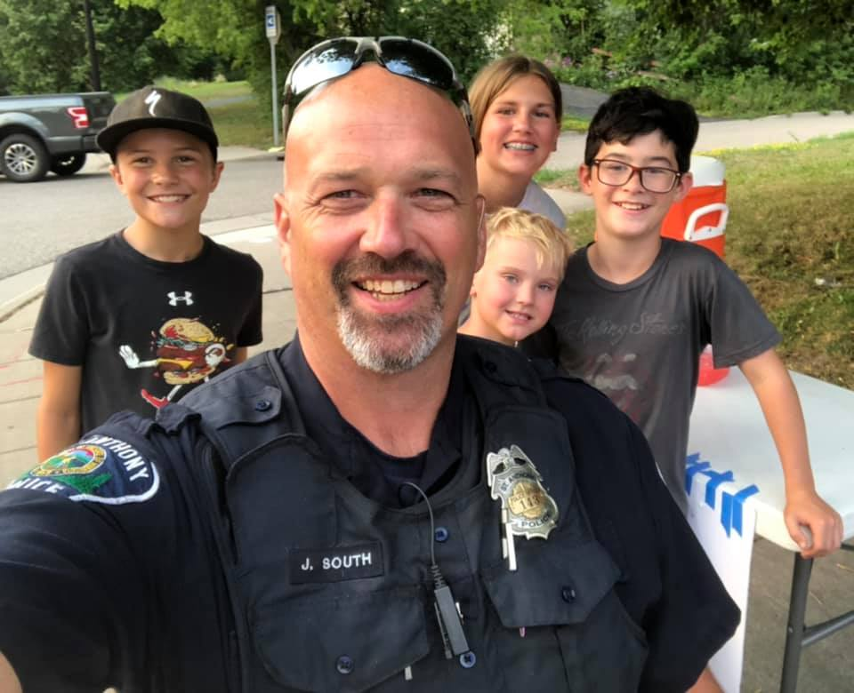
Community Engagement
Collaboration with SA Community Services to present bicycle safety event
Annual Summer Survival School/Safety Camp instructing 30 incoming 4th graders on topics such as bicycle safety, using 911, and fire safety
Speaking at Home Alone classes through Community Services
Notes:
Add info from Huddle

Slide 18
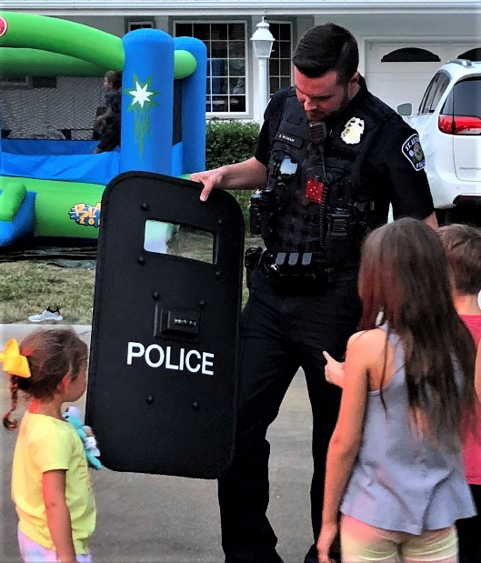
Community Engagement
Partnered with Cub Foods to offer “Hot Dogs with Police and Fire” event
Hosted Cops Vs Kids Basketball game event
Scam Prevention Seminars
Education and engagement through Social Media
MN Nite to Unite
Smart911
CatGuards (Catalytic Converter Theft Prevention)
Notes:
Add info from Huddle
Lights ON! and Driver Diversion Programs

Slide 19
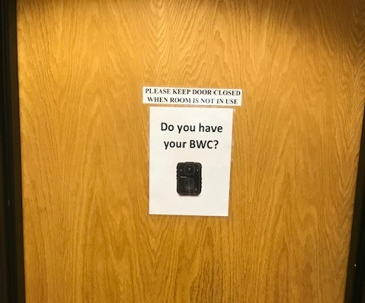
Body Worn Camera Program
Fourth full year of implementation
Passed required biennial audit conducted November 2022 with a 100% compliance
Continued monthly internal compliance checks:
457 videos reviewed
99.6% Compliance Rate
Video reviewed in all Use of Force incidences and allegations of officer misconduct.
Next biennial audit: November 2024
Notes:
2 videos out of compliance due to human error - errors in classification.

Slide 20
Progress Report
Continued performing Body Worn Camera (BWC) internal monthly auditing all officer’s Body Worn Camera’s.
Contracted with an auditor to conduct an independent audit of the St. Anthony Police Department’s Portable Recording System (Body Worn Cameras (BWCs)) on October 27, 2022. The objective of the audit was to verify St. Anthony Police Department’s compliance with Minnesota Statutes §§13.825 and 626.8473. No discrepancies were noted. Finding presented to St. Anthony City Council, the members of the State Legislative Commission on Data Practices and Personal Data Privacy.
January 2022 signed service agreements and began yearlong project of transitioning to a new Records Management System (RMS) platform. Target completion for data migration, system integration and staff training second quarter of 2023.
Implemented officer training based on protocols for investigating sexual assault cases as set forth by the MN POST Board. Training created 2020.
Continued training and employee development related to the department policy/procedure manual. Issue daily training bulletins that expanded officer knowledge and awareness pertaining to policy, applicable State/Federal and changes as a result of case law rulings.
Notes:
LEADS Online serves community.

Slide 21
Progress Report
Completed officer training that emphasizes officer skill development in areas associated to mental health concerns, de-escalation strategies and community relations.
Completed department training utilizing Integrating Communications, Assessment and Tactics (I.C.A.T.) into officer development and training. Focus on training platforms related to Use of Force, Emergency Medical Responder (EMR), Firearms and responding to persons in crisis.
Continued professional development of first line supervisors, as well as Office Manager, Officer Support Specialist, Lieutenant, Captain & Police Chief.
All officers completed League of MN Cities, MN POST Board approved, 2022 "Patrol Online" training for officers.
Adjusted Detective assignment tenure to allow for additional depth within the Investigative Unit.
Notes:
Graduate level Northwestern University Staff and Command Course 22 week.

Slide 22
Progress Report
Created an interface that allows the automated transfer of digital media to the Ramsey County Attorney’s Office.
Continued to evaluate methods for implementing online reporting for selected offenses.
Maintained police department membership with city wide involvement in the Government Alliance on Race and Equity.
Offered medicine disposal drop box services. Collected 455.20 lbs of pharmaceuticals and packaging.
Hired for vacancy at the position of Community Service Officer (CSO).
Hired for three vacancies at the position of police officer.
Created a hiring and staffing plan as we look to staffing needs in the next 1-5 years due to increased staffing needs and pending retirements.
Notes:
2021 Collected 318.6 lbs of pharmaceuticals and packaging.
Officer Sam Shafer (May), Officer Cody Boegeman (August) & Officer Brandon Hess (Left in April, returned December).

Slide 23
What’s On Deck
Continue work on data sharing pilot project with the Ramsey County Attorney’s Office and assist with onboarding other police agencies.
December 2021/January 2022 signed service agreements and began yearlong project of transitioning to a new Records Management System (RMS) platform. Target completion July 2023.
Identify and hire two qualified and eligible to be licensed candidates for full time police patrol officer positions.
Integrate our stolen property records to allow Ramsey County and Hennepin County dispatch centers the ability to enter or cancel stolen or recovered property after business hours.
Create an interface that allows the automated transfer of digital media to the City Attorney’s Office.
Partnered with Hyundai and Kia to obtain free steering wheel locks for residents.
Notes:
Vacancy of Lt. Dan Diegnau.
Upcoming separation of Cody Boegeman.

Slide 24
Just Arrived

Slide 25
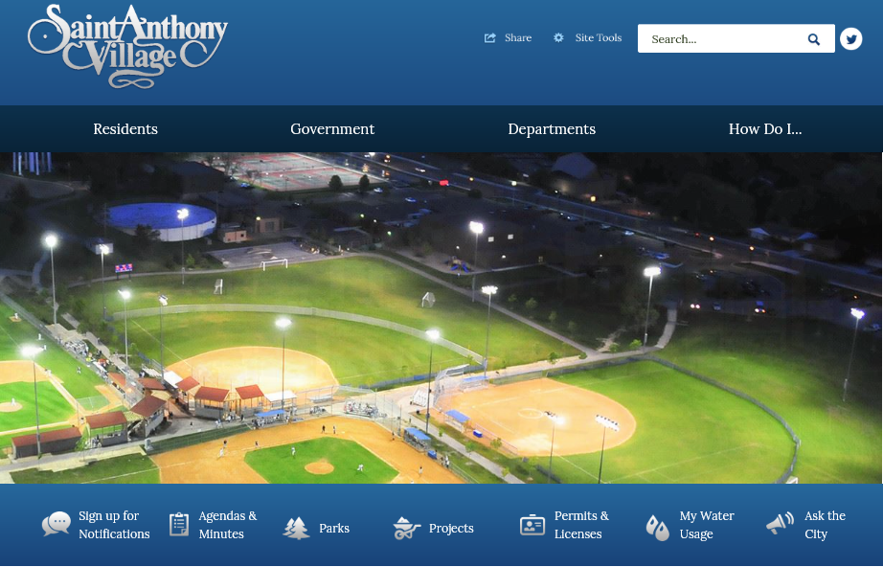
Stay Connected
Updates provided via the St. Anthony Village website. Sign up to be “Notified.”
Email us at police@savmn.com
Request police records at sapdrecords@savmn.com
Call us at 612-782-3350 to arrange for a meeting via phone or in person
Notes:
Follow us on social media – don’t necessarily have to have a social media account.

Slide 26
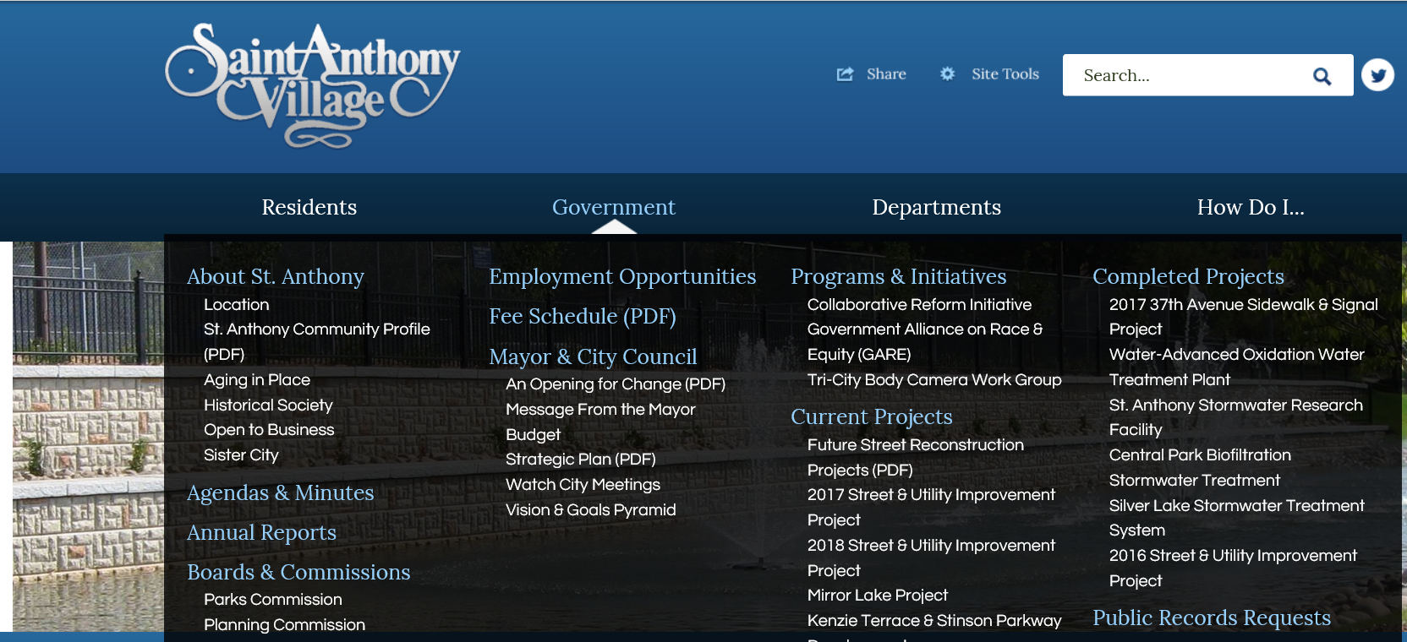
This report can be viewed online at: www.savmn.com
Notes:
Our website is continually being enhanced to include more depth of information - to include videos, request police reports and view the most recent annual reports.

